Slide 1
ART1 NETWORK
BY
ASST. PROF. N. L. MUDEGOL

Slide 2
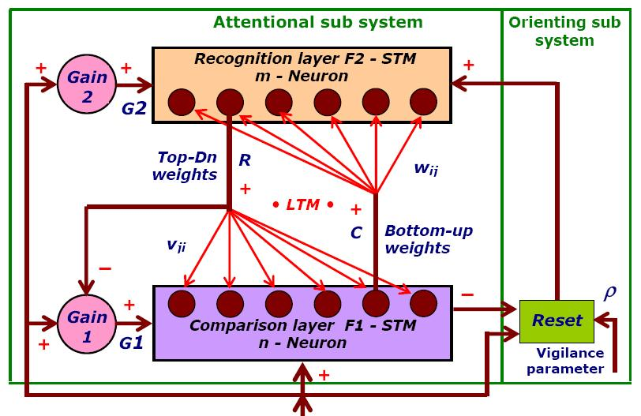
ART1 Architecture
Input vector

Slide 3
Neural network of ART1 consists of following:
A F₁ Layer (Input/ Comparison layer)
A node for each layer as a gain control unit
A F₂ Layer (Output layer / Recognition layer)
Bottom-up connection (F₁ to F₂)
Top-down connection (F₂ to F₁)
Inhibitory connections (-)(F₂ to gain control unit)
Excitatory connections (+)(gain control to layer)
Inhibitory connections (from F₁ to reset node)
Excitatory connections (from reset node to F₂ layer)

Slide 4
Classification decision is indicated by a single recognition layer neuron which fires.
The synaptic weights are modifiable between two layers
Recognition layer neurons have inhibitory connections that allow for competition
Through vigilance, recognition layer neuron is compared with original input vector
When vigilance falls below a threshold, new cluster must be created & input vector is stored in that cluster.

Slide 5
Features of ART1
Two-Third rule is used to determine the activity of F1 layer neuron.
3 input sources to F1 layer neuron:
External Input
Output of Gain control (G1)
Output of F2 layer neuron (R)
A gain control unit & 2/3 rule together ensure proper response from the input layer neuron.
Vigilance parameter is used to determine the activity of reset unit.
Activated when match is not found among existing patterns during classification.

Slide 6
ART1
Before starting the actual algorithm we need to set some parameters and must determine the size of the F1 and F2 layer.
Let consider,
  Number of neurons in F1 Layer = M
  Number of neurons in F2 layer = N

Slide 7
ART1
Other parameters are:
  A, B, C, D and L
  Must satisfy following constraints:
    A ≥ 0
    C ≥ 0
    D ≥ 0
    Max(D, 1) < B < D+1
    0 < ρ ≤ 1
  B must be chosen to satisfy the above constraint to implement 2/3 rule successfully to distinguish between TD & BU weights.

Slide 8

ART1
Top-down weight initialization:
  $${[td]}_{MxN}=Top−down weight matrix$$
  $${td}_{ij}^{0}> \frac{B−1}{D}$$

Slide 9

ART1
Bottom-up weight initialization:
  $${[bu]}_{NxM}=Bottom−up weight matrix$$
  $$0<{bu}_{ij}^{0}< \frac{L}{L−1+M}$$

Slide 10

ART1
The activities on F2 are initialized to 0 butF1 activities are initialized to:
$$x_{i}= \frac{−B}{1+C}$$
All input patterns must be binary I. The norm of vector is equal to the sum of the components:
$$|I|= \sum_{i=1}^{M}{I_{i}}$$

Slide 11

ART1 ALGORITHM
STEP 1:
Apply an input vector I to F1 layer.
Compute the F1 layer activities as follows:
$$X_{i}= \frac{I_{i}}{1+A\left(I_{i}+B\right)+C}$$
for i = 0, 1, …, M

Slide 12

ART1 ALGORITHM
STEP 2:
Calculate the output vector of F1 layer
$$S_{i}=h\left(X_{i}\right)=\left\{\begin{aligned}1, ifX_{i}>0 \\ &0, ifX_{i}≤0\end{aligned}\right.$$
for i = 0, 1, …, M

Slide 13

ART1 ALGORITHM
STEP 3:
Propagate S forward to F2 layer and compute the activities using:
$${\{T\}}_{Nx1}= {[bu]}_{NxM}x{\{S\}}_{Mx1}$$

Slide 14

ART1 ALGORITHM
STEP 4:
Assign value 1 as output to the neuron with maximum net input the winning neuron.
$$u_{j}=\left\{\begin{aligned}1, T_{j}=max⁡\{T_{k}\} \text{∀}\text{k} \\ &0, Otherwise\end{aligned}\right.$$
Output will be vector:
$${\{u\}}_{Nx1}$$

Slide 15
ART1 ALGORITHM
STEP 4:
If all outputs are equal, i.e. all net inputs are same, then select the first neuron as a winner.
Assume J as winning neuron.

Slide 16

ART1 ALGORITHM
STEP 5:
Propagate output from F2 layer to F1 layer and calculate the net inputs from F2 to F1 layer as follows:
$${\{V\}}_{Mx1}= {[td]}_{MxN}x{\left\{u\right\}}_{Nx1}$$

Slide 17

ART1 ALGORITHM
STEP 6:
Compute the new activities according to following equation:
$$X_{i}=\frac{I_{i}+DV_{i}−B}{1+A\left(I_{i}+DV_{i}\right)+C}$$

Slide 18

ART1 ALGORITHM
STEP 7:
Determine new output vector {S} as in step 2.
$$S_{i}=h\left(X_{i}\right)=\left\{\begin{aligned}1, ifX_{i}>0 \\ &0, ifX_{i}≤0\end{aligned}\right.$$
for i = 0, 1, …, M

Slide 19

ART1 ALGORITHM
STEP 8:
Determine the degree of match between input pattern and top-down template as:
$$\frac{|S|}{|I|}= \frac{\sum_{i=1}^{M}{S_{i}}}{\sum_{i=1}^{M}{I_{i}}}$$

Slide 20

ART1 ALGORITHM
STEP 9:
If $\frac{|S|}{|I|}<$ρ, mark J as inactive, zero the outputs of F2 layer and return to step 1 using the original pattern.
If the value is greater than or equal to ρ then continue.

Slide 21

ART1 ALGORITHM
STEP 10:
Update the bottom-up weights on J only as follows:
$${[bu]}_{J, i} =\left\{\begin{aligned}\frac{L}{L−1+|S|} if i is active \\ &O, if i is inactive\end{aligned}\right.$$

Slide 22

ART1 ALGORITHM
STEP 11:
Update the top-down weights coming from only J to all F1 layer neurons as follows:
$${[td]}_{i,j} =\left\{\begin{aligned}1, if i is active \\ &O, if i is inactive\end{aligned}\right.$$

Slide 23
ART1 ALGORITHM
STEP 12:
Remove the input pattern.
Restore all inactive F2 layer neurons.
Return to step 1 with new input pattern.

Slide 24

SOLVED EXAMPLE
Given input matrix:
$$\left[I\right]=\left[\begin{aligned}0 0 0 1 0 \\ 0 0 1 0 1 \\ 0 0 0 0 1\end{aligned}\right]$$
Other Parameters:
M = 5, N = 6;
A = 1, B = 1.5, C = 5, D = 0.9;
ρ= 0.9 and L = 5

Slide 25
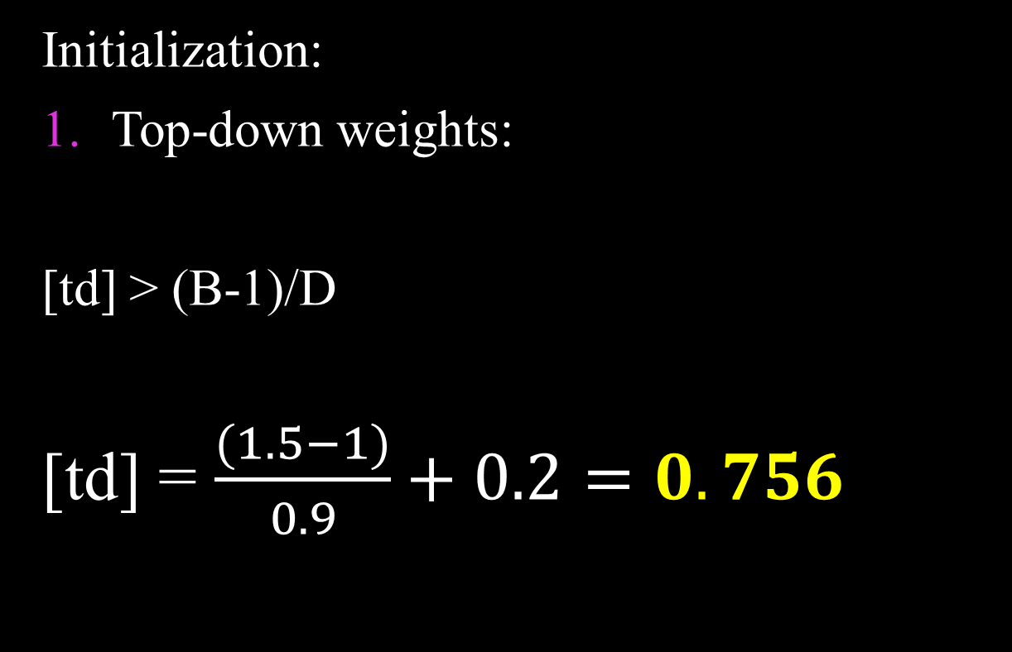
SOLVED EXAMPLE
Initialization:
Top-down weights:
[td] > (B-1)/D
[td] = $\frac{(1.5−1)}{0.9}+0.2=0.756$

Slide 26

SOLVED EXAMPLE
Initialization:
Top-down weights:
$${[td]}_{5∗6}=\left[\begin{aligned}0.756 0.756 0.756 0.756 0.756 0.756 \\ 0.756 0.756 0.756 0.756 0.756 0.756 \\ 0.756 0.756 0.756 0.756 0.756 0.756 \\ 0.756 0.756 0.756 0.756 0.756 0.756 \\ 0.756 0.756 0.756 0.756 0.756 0.756\end{aligned}\right]$$

Slide 27
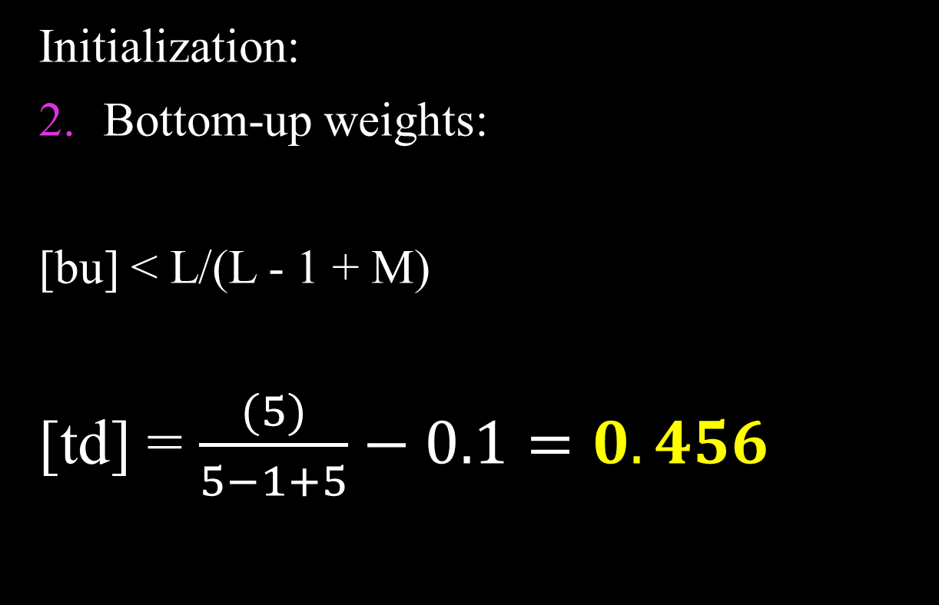
SOLVED EXAMPLE
Initialization:
Bottom-up weights:
[bu] < L/(L - 1 + M)
[td] = $\frac{(5)}{5−1+5}−0.1=0.456$

Slide 28

SOLVED EXAMPLE
Initialization:
Bottom-up weights:
$${[bu]}_{6∗5}=\left[\begin{aligned}0.456 0.456 0.456 0.456 0.456 \\ 0.456 0.456 0.456 0.456 0.456 \\ 0.456 0.456 0.456 0.456 0.456 \\ 0.456 0.456 0.456 0.456 0.456 \\ 0.456 0.456 0.456 0.456 0.456 \\ 0.456 0.456 0.456 0.456 0.456\end{aligned}\right]$$

Slide 29

SOLVED EXAMPLE
Now, select the first input pattern.
i.e.
[I1] = $\left\{\begin{aligned}0 \\ 0 \\ 0 \\ 1 \\ 0\end{aligned}\right\}$
$${{<I}_{1}>}^{T}= <0 0 0 1 0>$$

Slide 30

SOLVED EXAMPLE
Step 1:
Compute the F1 layer activities as follows:
$$X_{i}= \frac{I_{i}}{1+A\left(I_{i}+B\right)+C}$$
e.g. $X_{1_{4}}=\frac{1}{1+1\left(1+1.5\right)+5}= \frac{1}{8.5}=0.118$
So,
${X_{1}}^{T}$ = <0 0 0 0.118 0>

Slide 31

SOLVED EXAMPLE
Step 2:
Output Vector of F1 layer is:
(If Xi > 0, set it to 1; otherwise 0)
$<S^{T}>$ = <0 0 0 1 0>

Slide 32

SOLVED EXAMPLE
Step 3:
Compute the activities at F2 layer as follows:
$${\{T\}}_{N∗1}= {[bu]}_{N∗M}∗{\{S\}}_{M∗1}$$
$${\{T\}}_{6∗1}= {[bu]}_{6∗5}∗{\{S\}}_{5∗1}$$

Slide 33

SOLVED EXAMPLE
Step 3:
$$\left[\begin{aligned}0.456 0.456 0.456 0.456 0.456 \\ 0.456 0.456 0.456 0.456 0.456 \\ 0.456 0.456 0.456 0.456 0.456 \\ 0.456 0.456 0.456 0.456 0.456 \\ 0.456 0.456 0.456 0.456 0.456 \\ 0.456 0.456 0.456 0.456 0.456\end{aligned}\right]∗\left[\begin{aligned}0 \\ 0 \\ 0 \\ 1 \\ 0\end{aligned}\right]$$
{T}6*1= $\left[\begin{aligned}0.456 \\ 0.456 \\ 0.456 \\ 0.456 \\ 0.456 \\ 0.456\end{aligned}\right]$

Slide 34

SOLVED EXAMPLE
Step 4:
Compute the vector u such that neuron with maximum net input will have value 1 and others will have value 0.
Here, all Tj have same value. So, take the first neuron as winner.
$$u^{T}= <1 0 0 0 0 0>$$

Slide 35

SOLVED EXAMPLE
Step 5:
Calculate the {V} as follows:
$${\{V\}}_{M∗1}= {[td]}_{M∗N}∗{\left\{u\right\}}_{N∗1}$$
$${\{V\}}_{5∗1}= {[td]}_{5∗6}∗{\left\{u\right\}}_{6∗1}$$

Slide 36

SOLVED EXAMPLE
Step 5:
$${\{V\}}_{5∗1}=$$
$\left[\begin{aligned}0.756 0.756 0.756 0.756 0.756 0.756 \\ 0.756 0.756 0.756 0.756 0.756 0.756 \\ 0.756 0.756 0.756 0.756 0.756 0.756 \\ 0.756 0.756 0.756 0.756 0.756 0.756 \\ 0.756 0.756 0.756 0.756 0.756 0.756\end{aligned}\right]\left[\begin{aligned}1 \\ 0 \\ 0 \\ 0 \\ 0 \\ 0\end{aligned}\right]$ = $\left[\begin{aligned}0.756 \\ 0.756 \\ 0.756 \\ 0.756 \\ 0.756\end{aligned}\right]$

Slide 37

SOLVED EXAMPLE
Step 6:
Calculate the new activities at F1 layer as follows:
$$X_{i}=\frac{I_{i}+DV_{i}−B}{1+A\left(I_{i}+DV_{i}\right)+C}$$
e.g.
$$X_{11}= \frac{0+\left(0.9∗0.756\right)−1.5}{1+1\left(0+\left(0.9∗0.756\right)\right)+5}=\frac{−0.8196}{6.6804}$$
$X_{11}$ = -0.123

Slide 38

SOLVED EXAMPLE
Step 6:
$$X_{5∗1}= \left[\begin{aligned}−0.123 \\ −0.123 \\ −0.123 \\ 0.023 \\ −0.123\end{aligned}\right]$$
$$X^{T}= <−0.123 −0.123 −0.123 0.023 −0.123>$$

Slide 39

SOLVED EXAMPLE
Step 7:
Now calculate new output vector S.
(If Xi > 0, set it to 1; otherwise 0)
$$S_{5∗1}= \left[\begin{aligned}0 \\ 0 \\ 0 \\ 1 \\ 0\end{aligned}\right]$$
$$S^{T}= <0 0 0 1 0 >$$

Slide 40

SOLVED EXAMPLE
Step 8:
Determine the degree of match as follows:
$$\frac{|S|}{|I|}$$
|S| = 1 and |I|=1
$\frac{|S|}{|I|}$ = 1/1 = 1 > r = 0.9

Slide 41
SOLVED EXAMPLE
Step 9:
As degree of matching is greater than r there is no reset.
And we can say resonance reached for the given input pattern.

Slide 42

SOLVED EXAMPLE
Step 10:
Update bottom-up weights on J only as follows:
$${[bu]}_{J, i} =\left\{\begin{aligned}\frac{L}{L−1+|S|} if i is active \\ &O, if i is inactive\end{aligned}\right.$$

Slide 43

SOLVED EXAMPLE
Step 10:
Here only neuron 4 has value 1 i.e. it is active and all others are inactive.
$${[bu]}_{1, 4} =\frac{L}{L−1+|S|}= \frac{5}{4+1}=1$$
And all others will be 0.

Slide 44

SOLVED EXAMPLE
Step 10:
So, updated weight matrix will be
$${[bu]}_{6∗5}= \left[\begin{aligned}0 0 0 1 0 \\ 0.456 0.456 0.456 0.456 0.456 \\ 0.456 0.456 0.456 0.456 0.456 \\ 0.456 0.456 0.456 0.456 0.456 \\ 0.456 0.456 0.456 0.456 0.456 \\ 0.456 0.456 0.456 0.456 0.456\end{aligned}\right]$$

Slide 45

SOLVED EXAMPLE
Step 11:
Also, update the top-down weight matrix as follows:
$${[td]}_{i,j} =\left\{\begin{aligned}1, if i is active \\ &O, if i is inactive\end{aligned}\right.$$
Here also, only 4th neuron will have value 1 and others will have value 0.

Slide 46

SOLVED EXAMPLE
Step 11:
So, updated weight matrix will be
$${[td]}_{5∗6}= \left[\begin{aligned}0 0.756 0.756 0.756 0.756 0.756 \\ 0 0.756 0.756 0.756 0.756 0.756 \\ 0 0.756 0.756 0.756 0.756 0.756 \\ 1 0.756 0.756 0.756 0.756 0.756 \\ 0 0.756 0.756 0.756 0.756 0.756\end{aligned}\right]$$

Slide 47
SOLVED EXAMPLE
Step 12:
Remove input pattern. Restore all inactive F2 neurons and start from step 1 with new input pattern.

Slide 48
SLOW AND FAST LEARNING
ART considers two types of learning:
FAST LEARNING:
  Weight update occurs fast relative to the length of time a pattern is presented to the network for learning.
  The weights reach equilibrium very fast on each learning.
  Each pattern gets classified to the correct cluster without requiring reset mechanism.
  E.g. ART1

Slide 49
SLOW AND FAST LEARNING
FAST LEARNING:
  In ART1, inputs and outputs are binary.
  Also, input patterns are more related because of only 2 values (0 and 1).
  So, most of the pattern classification is done without or few number of reset operations.

Slide 50
SLOW AND FAST LEARNING
SLOW LEARNING:
  Weight update occurs slow relative to the length of time a pattern is presented to the network for learning.
  The weights reach equilibrium very slow on each learning.
  Classification of input pattern to correct cluster requires many resets.
  E.g. ART2

Slide 51
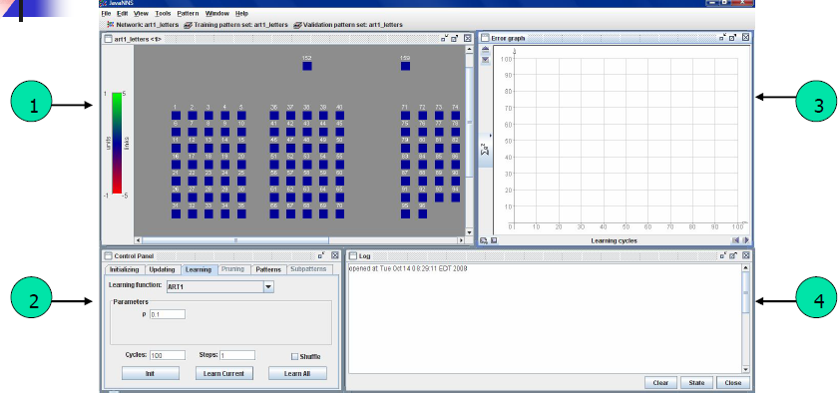
ART Simulator (JNNS)
There are many parts to the simulator, but four are shown here:
1. ART Network 2. Control Panel
3. Error graph (not always used) 4. Log (optional)

Slide 52
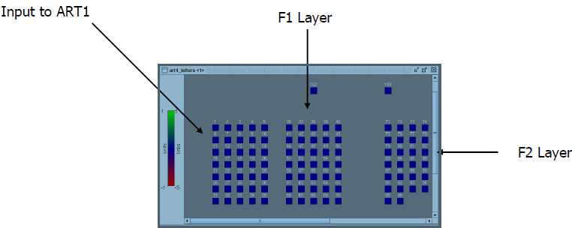
ART Simulator (JNNS)
For this specific simulation, the input is a 5x7 grid of nodes that represent an upper-case letter in the English alphabet.
There are 35 (5x7) nodes in the F1 layer representing the best hypothesized letter learned so far, and 26 nodes within the F2 layer, each representing a possible letter in the alphabet.

Slide 53
ART Simulator (JNNS)
Example: We want the Java NNS to recognize the letter “Z”.
Note: The 26 nodes in the F2 layer are numbered 71 – 96.
After looking through the source, I found that “Z” corresponds to node 85.
Therefore, this NNS should select that as the winning node as it should be the closest match to any hypothesis made by the F2 layer.
To start:
• Input to the ART is the letter “Z”.
• Each node in F2 represents a letter to be matched against.
• ρ = 0.1

Slide 54
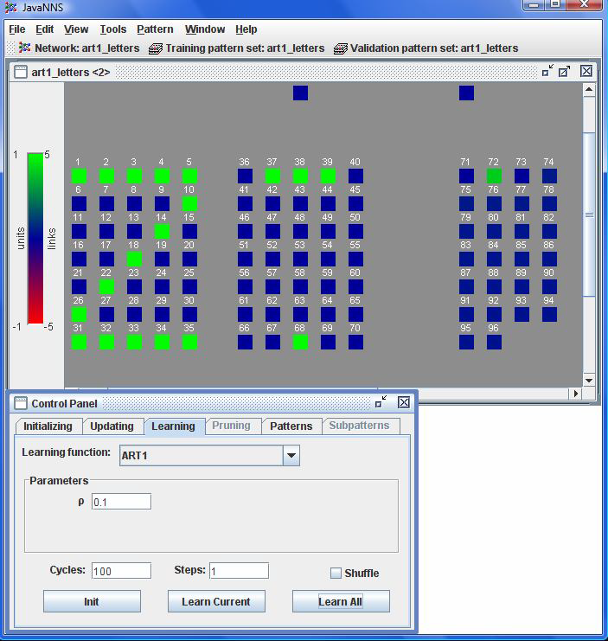
ART Simulator (JNNS)
We can see that the ART1 network learned poorly.
How do we know this?
1. Input layer shows the input was “Z”, but the F1 layer is not even a character.
2. Node 72 in the F2 layer is selected as being the most probable letter.
It should be node 85.
What do you think went wrong?

Slide 55
ART Simulator (JNNS)
Answer: The vigilance parameter ρ was too small (ρ=0.1). As a result, very general memories were being formed and the letter was not determined correctly.
By increasing to ρ=0.9, we see the pattern learned in the F1 layer is in fact “Z” and node 85 in the F2 layer is selected as being the most likely letter.
Drawback: it takes a bit longer to learn with a higher vigilance value than with a smaller one.

Slide 56
ART Simulator (JNNS)
Pros:
  1. Very nice and neat graphical user interface.
  2. Supports 25+ neural network architectures.
  3. Cross platform.
  4. Efficient and memory inexpensive.
Cons:
  1. Multiple errors and poor error handling (program crashed multiple times).
  2. Poor instruction manual (authors keep telling you to refer to other sources).
  3. Not all functionality is explained, leaving the user at a loss at times.
  4. Adds “temporary” files to the user’s machine without deleting or announcing it.

Slide 57
APLLICATIONS OF ART1
Character Recognition
Soil Classification
Clustering Web Users

Slide 58
Clustering Web Users
Consider the case of having a dynamic website consisting of multiple components and each user access each component a certain number of times.
How would you redesign the website to provide the most commonly used components to that specific user without being impractical in implementation?
This was the question behind:
Adaptive Neural Network Clustering of Web Users (see reference: Santosh K. Rangarajan, Vir V. Phoha, Kiran S. Balagani, Rastko R.Selmic, S.S. Iyengar, "Adaptive Neural Network Clustering of Web Users," Computer, Vol. 37, No. 4, pp. 34-40, Apr., 2004).

Slide 59
Clustering Web Users…
Define:
  1. M = 200: Number of unique components – F1 layer
  2. N: Num. of organizational clusters that users are grouped into – F2 layer
  3. H = 70: Number of users

Slide 60
Clustering Web Users…
Usage information for each component, per user, can be found in the usage logs recorded on the backend server.
Algorithm:
  1. Extract the web logs pertaining to the given user.
  2. Extract usage for each possible component using the logs.
  3. After assigning weights to each component based on usage, use the ART1 network architecture to determine best possible combination for that user.
  4. Repeat this process for each user to achieve the best grouping of users within the F2 layer.
Result is a layer of clusters of organizational types where each user is within a cluster.

Slide 61
Clustering Web Users…

Slide 62
Clustering Web Users…
Fig (a) shows the intercluster distance within each cluster formed using ART1 and compared with K-Means Clustering.
Fig (b) shows the intracluster distances between clusters.

Slide 63
Clustering Web Users…
Results:
Vigilance parameters of 0.3 through 0.5 were used, producing between 20 and 52 distinct clusters.
Accuracy of clustering for each user ranged from 82% to 97%, with an error producing one user at 12%. Accuracy was determined by checking the usage logs for each user for 13 days after this experiment was conducted and comparing usage.

Slide 64
ART Summary
Solves Stability – Plasticity Dilemma.
Forms new memories or incorporates new information based on a predefined vigilance parameter.
Higher vigilance produces more detailed memories, lower vigilance produces more general memories.
Extended to ART2, ARTMAP, Fuzzy ART, etc.

